Slide 1
EYE COLOR DETECTION

Slide 2
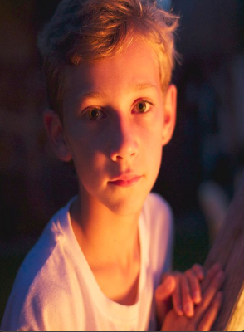
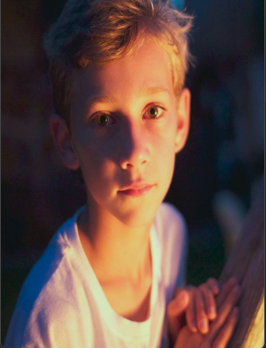
White Balancing with Gray World Assumption
Furher information: https://pippin.gimp.org/image-processing/chapter-automaticadjustments.html

Slide 3
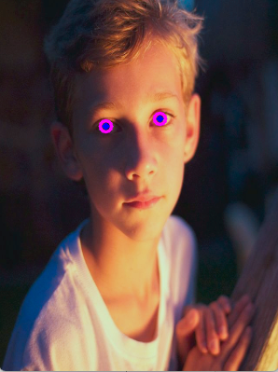
IRIS DETECTION
Google mediapipe facemesh landmarks are utilized
Four points of iris can be detected by mediapipe
Pupil is discarded with the assumption of :
radius of pupil = radius of iris / 3

Slide 4
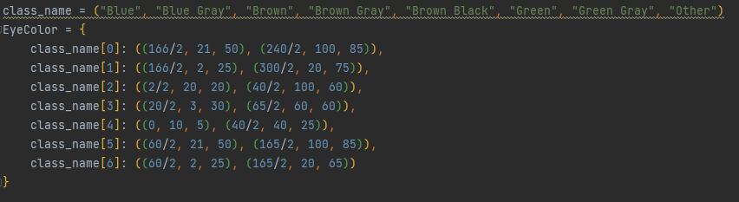
COLOR DETECTION
Pre determined HSV domain of eye colors:
Voting algorithm determines the color which exists most in the iris region.

Slide 5

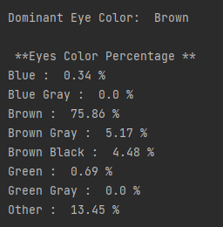
Example Results
1)

Slide 6
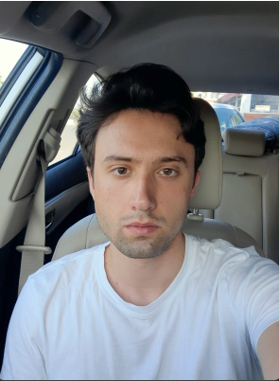
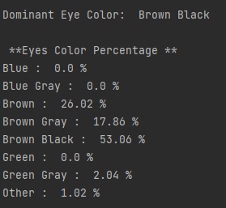
2)

Slide 7
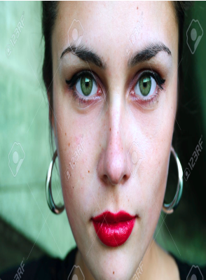
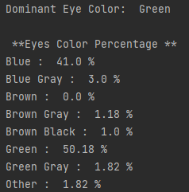
3)

Slide 8
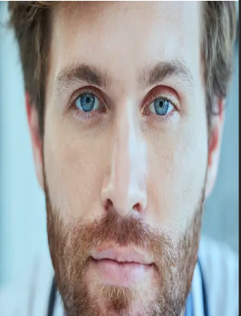
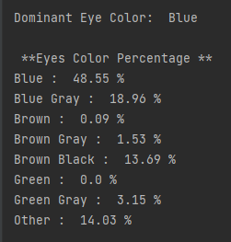
4)

Slide 9
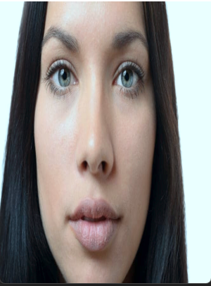
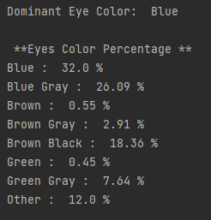

Slide 10
FURTHER WORK
The predetermined HSV ranges should be optimized by experiments.

